Slide 1

UAE Progress toward 2050 Solar Energy Targets
A comprehensive analysis of the United Arab Emirates' solar energy development, policy framework, and strategic outlook from 2025 to 2050
AI-Generated Presentation • Confidential

Slide 2
Executive Summary
1
2
3
4
5
Solar Capacity
Renewable Energy Target
Cost Competitiveness
Economic Benefits
Environmental Impact
3,860 MW as of mid-2025
14 GW by 2030
12 fills/kWh for solar energy
Significant job creation and investment
Reduced carbon emissions
2

Slide 3

UAE Energy Strategy 2050
1
Aims to increase renewable energy share to 50% by 2050
Introduction to UAE Energy Strategy 2050
Solar Energy Targets
2
25% of total energy mix by 2050
Investment Opportunities
3
AED 150 billion in renewable energy investments by 2050
Job Creation
4
Expected to create over 10,000 jobs in the solar energy sector
Environmental Benefits
5
Reduced carbon emissions and improved air quality
3

Slide 4
Key Performance Indicators
SOLAR CAPACITY
RENEWABLE ENERGY SHARE
COST COMPETITIVENESS
ECONOMIC BENEFITS
3,860 MW
25%
12 fills/kWh
AED 10 billion
as of mid-2025
of total energy mix by 2050
for solar energy
in annual savings by 2050
4

Slide 5
Challenges and Opportunities
CHALLENGES
OPPORTUNITIES
High Upfront Costs: Initial investment in solar energy infrastructure
Job Creation: Opportunities for employment in the solar energy sector
Intermittent Energy Supply: Dependence on weather conditions
Environmental Benefits: Reduced carbon emissions and improved air quality
Energy Storage: Limited storage capacity for excess energy
Economic Benefits: Cost savings and increased energy independence
5

Slide 6
UAE Solar Capacity by Type
SOLAR SYSTEM TYPE
INSTALLED CAPACITY (MW)
SHARE OF TOTAL SOLAR CAPACITY (%)
ANNUAL GENERATION (GWH)
Utility-Scale PV
3,420
88.6
6,840
Distributed PV
320
8.3
560
Concentrated Solar Power
120
3.1
380
**Total**
**3,860**
**100.0**
**7,780**
4 records · 4 metrics · Source: Document Analysis
6

Slide 7
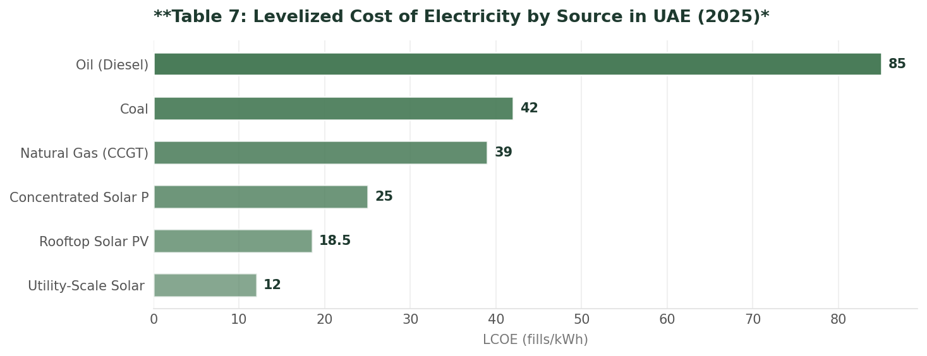
Levelized Cost of Electricity by Source
Data visualization from document analysis
📊
7

Slide 8
Key Drivers of Solar Energy Growth
01
02
03
04
Government Support
Technological Advancements
Investment Opportunities
Environmental Awareness
Policies and incentives for solar energy development
Improved efficiency and reduced costs
Increased investment in solar energy infrastructure
Growing concern for climate change and sustainability
8

Slide 9

Projected Solar Capacity
1
25 GW by 2050
Future Outlook and Projections
Renewable Energy Share
2
50% of total energy mix by 2050
Economic Benefits
3
AED 50 billion in annual savings by 2050
Job Creation
4
Expected to create over 50,000 jobs in the solar energy sector
Environmental Benefits
5
Reduced carbon emissions and improved air quality
9

Slide 10

Conclusion and Recommendations
→
UAE on track to meet solar energy targets
→
Cost competitiveness achieved
→
Economic benefits significant
→
Environmental benefits substantial
→
Recommendations: Continue to invest in solar energy infrastructure
10

Slide 11
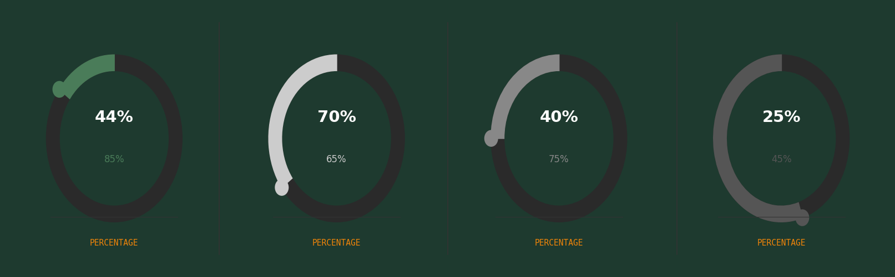
Key Performance Indicators
11

Slide 12
Solar Energy Development Pillars
Policy Framework
Infrastructure Development
Technological Advancements
International Cooperation
Supporting policies and regulations
Investment in solar energy infrastructure
Improved efficiency and reduced costs
Collaboration with international organizations
12

Slide 13
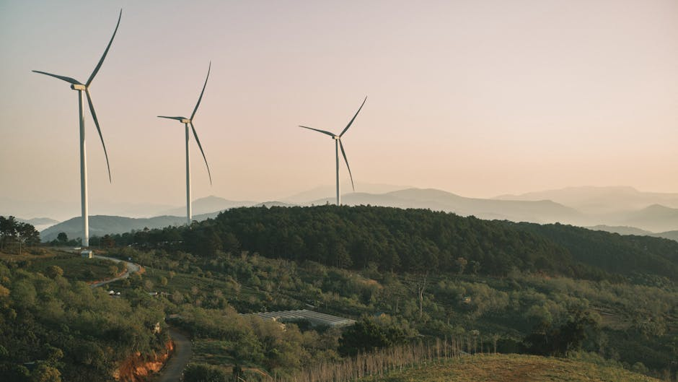
UAE to Reach 25% Renewable Energy Share by 2050
→
UAE to reach 25% renewable energy share by 2050
→
Solar energy to play a significant role
→
Economic benefits to reach AED 50 billion
→
Environmental benefits to reduce carbon emissions
13

